Slide 1
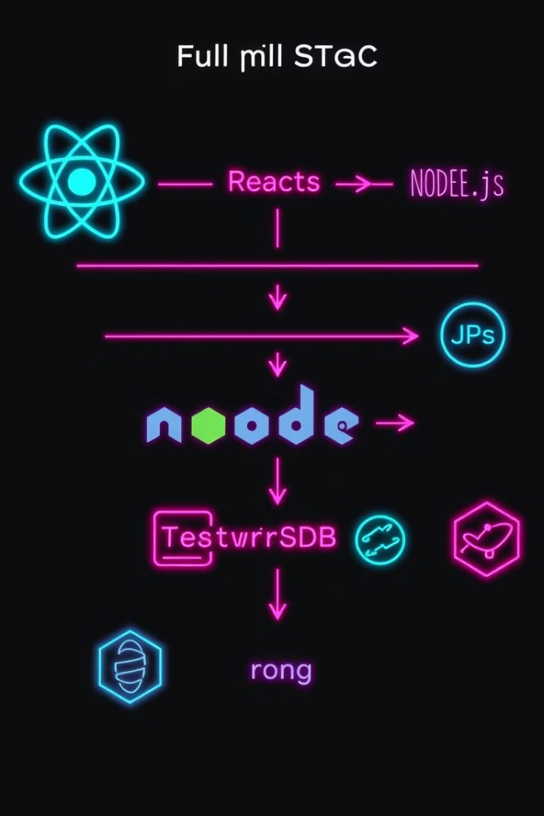

My MLSA Internship: Full-Stack Development Journey
This presentation showcases my internship experience at MLSA. During this internship, I gained hands-on experience in full-stack web development, including database technologies, React.js, Node.js, and building two projects: a Todo List App and a Calculator App.
by Naman Bansal

Slide 2



Introduction: Naman Bansal
My name is Naman Bansal, a student in the CSE branch at KIET Group of Institution. I completed my internship at MLSA.
CSE Branch
Roll No: 2200290100106
I am a student in the Computer Science and Engineering branch.
My roll number is 2200290100106.

Slide 3

Diving into React.js Fundamentals
1
Components
I learned about React.js components, which are reusable building blocks for UI elements. They encapsulate functionality and state, making it easier to create complex user interfaces.
2
JSX
I gained experience with JSX, a syntax extension for JavaScript that allows writing HTML-like structures within JavaScript code, making it easier to build dynamic user interfaces.
3
State Management
I learned about state management in React.js, including using the useState hook to manage component state and the useEffect hook for handling side effects.

Slide 4
Mastering Node.js and Server-side Development
Node.js Fundamentals
Express.js Framework
HTTP and RESTful APIs
I learned about Node.js, a JavaScript runtime environment that allows you to build server-side applications using JavaScript.
I explored the Express.js framework, a popular and lightweight framework for building Node.js applications, enabling me to create web servers and APIs with ease.
I gained an understanding of HTTP protocols and RESTful API design principles, allowing me to create web services that can be accessed by other applications.

Slide 5
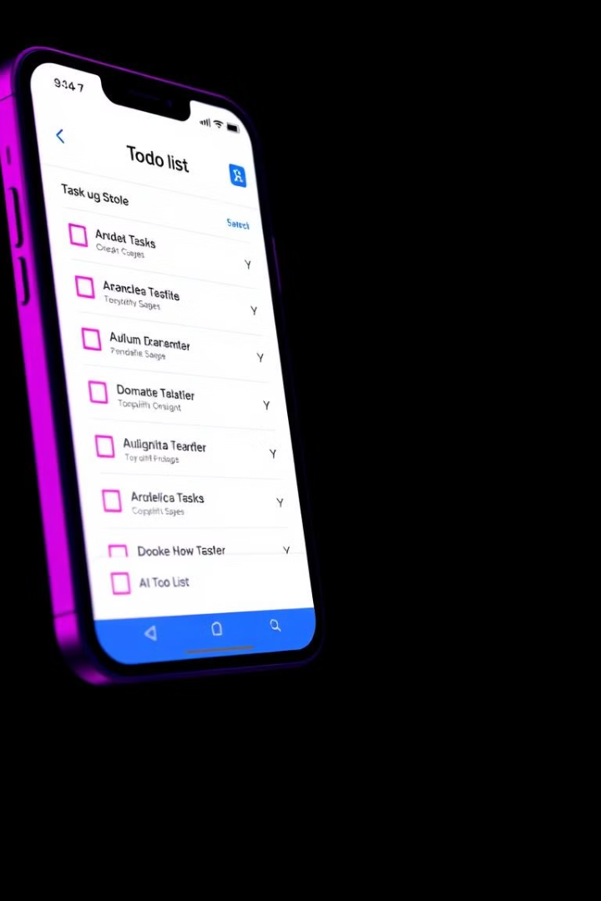



Designing a Todo List App in React.js
User Interface
I designed a user-friendly interface with input fields for adding new tasks, a list to display existing tasks, and checkboxes for marking tasks as complete.
Functionality
The app allows users to add, delete, and update tasks, as well as mark them as completed or incomplete.
State Management
I used React.js state management techniques to handle task data, ensuring that changes made to the app's state are reflected in the user interface.

Slide 6
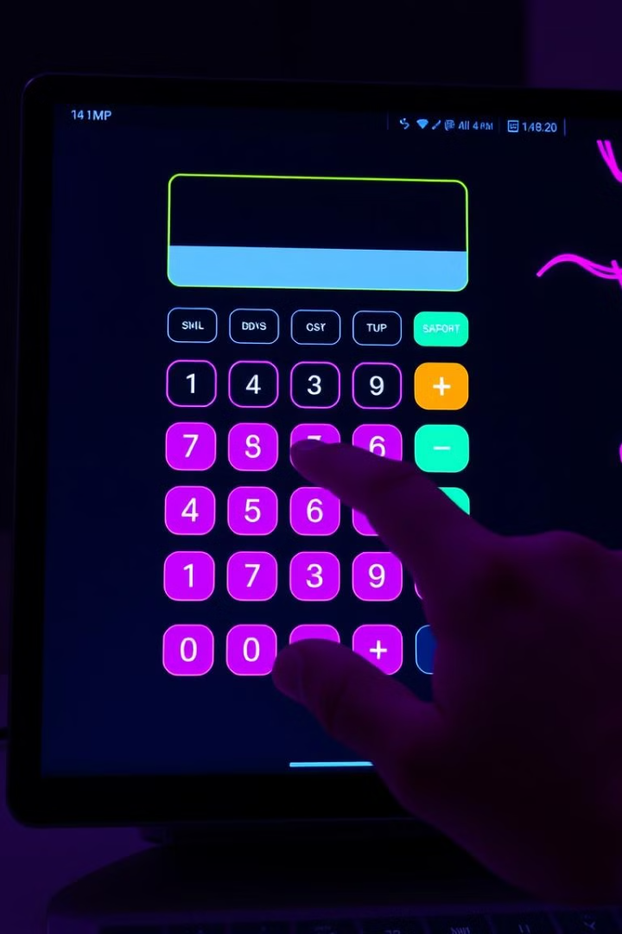
Developing a Calculator App in React.js
Functionality
Description
Basic Operations
The calculator app supports basic arithmetic operations: addition, subtraction, multiplication, and division.
Advanced Functions
The app also includes functions like square root, percentage, and memory operations, enhancing its capabilities.
User Interface
The app features a user-friendly interface with clear buttons and a display that provides real-time feedback on calculations.

Slide 7

Key Takeaways and Next Steps
Problem-Solving
Self Growth
This internship honed my problem-solving skills, as I encountered and resolved various challenges in coding and debugging applications.
This Internship helped me to build my knowledge and to give confidence in the project building
Continuous Learning
This experience has instilled in me a commitment to continuous learning, staying updated on the latest technologies and trends in the field of web development.

Slide 8

Thanking You

